Slide 1


AI-Powered Enterprise Assistant
Revolutionizing Knowledge Retrieval through RAG and Natural Language SQL Querying.

Slide 2

The Core Challenge
Information Silos in Modern Enterprises

Slide 3

UNSTRUCTURED VS STRUCTURED
Static Documentation
Complex Databases
Knowledge is locked in millions of PDFs, scanned images, and internal reports. Manual retrieval is slow, error-prone, and lacks context-aware intelligence.
Relational databases require technical expertise (SQL) to query. Non-technical decision makers are often blocked by engineering bottlenecks.

Slide 4

THE UNIFIED SOLUTION
Our platform bridges the gap by providing a single interface to query both document repositories and structured databases using natural language.
Retrieval Augmented Generation: Real-time context grounding for accuracy.
AI SQL Agent: Zero-shot translation of prompts into safe database queries.
OCR Integration: Processing handwritten and scanned documents with precision.

Slide 5






PLATFORM CAPABILITIES
Advanced RAG
SQL Automation
OCR & Vision
Contextual embedding and semantic search using vector databases for unstructured data.
Safe execution of read-only SQL queries generated dynamically by LLM agents.
Extracting high-fidelity text from images and complex document layouts.

Slide 6
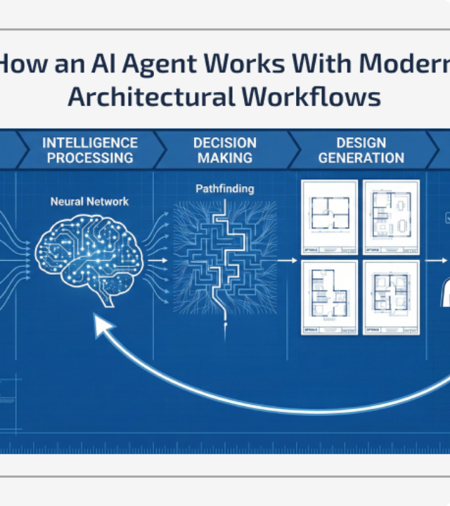

SYSTEM ARCHITECTURE
Our architecture utilizes a LangChain-powered orchestrator to route user queries between Vector Stores and Relational DBs.
The system ensures that responses are grounded in factual enterprise data, reducing LLM hallucinations to near zero.

Slide 7

RETRIEVAL ACCURACY TRENDS
Continuous fine-tuning and agentic routing have improved system accuracy to 98.5% over a 6-month evaluation period.

Slide 8

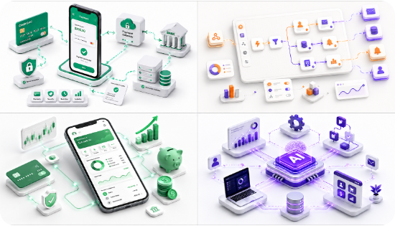
NATURAL LANGUAGE TO SQL
Zero-Trust Data Access
The SQL Agent converts high-level business questions directly into queries, shielding the actual database schema from end-users.
•
Automated Join resolution.
•
Read-only security constraints.
•
Instant visualization of results.

Slide 9
OPERATIONAL EXCELLENCE
85%
Measured Enterprise Impact
By automating the retrieval process across structured and unstructured silos, we empower teams to make decisions in minutes rather than days. The system processes thousands of query requests per second with negligible latency.
Reduction in Search Time

Slide 10



MODERN TECHNOLOGY STACK
Streamlit
LangChain
OpenAI
FAISS
Fast, interactive frontend deployment.
Robust LLM orchestration and agents.
State-of-the-art inference engines.
High-speed vector similarity search.

Slide 11
The Future of Intelligence
Expanding to Multi-Modal agents and Enterprise SSO integration for global scale.

Slide 12
Questions & Discussion
Thank you for your attention.
AI-POWERED ENTERPRISE ASSISTANT | AUGUST 2026

Slide 13





IMAGE SOURCES
https://lookaside.fbsbx.com/lookaside/crawler/media/?media_id=1357646676547626
Source: www.facebook.com
https://www.sparkouttech.com/amp/img/architecture-ai-agent-blog/ai-agent-works-with-modern-architectural-workflows.webp
Source: www.sparkouttech.com
https://miro.medium.com/1*C1sOu3U3R8o8Hmar_28Cmg.png
Source: medium.com
https://static.vecteezy.com/system/resources/previews/075/389/938/non_2x/abstract-dark-blue-technology-background-with-sharp-glowing-light-streaks-for-cyber-security-concept-futuristic-data-network-wallpaper-and-high-tech-digital-presentation-design-vector.jpg
Source: www.vecteezy.com
https://images.stockcake.com/public/f/e/0/fe02229c-fff4-479c-99df-98e98382540a_large/futuristic-office-management-stockcake.jpg
Source: stockcake.com

